Slide 1
A Strategic Educational Framework for Financial Literacy
Animation and Gamification-Based Learning for Children Empowerment
Supervisor:
Professor Dr. Md. Abdul Mannan Mondal
Department of Computer Science and Engineering
Dhaka City College
Submitted By:
Ishan Shahnan
Registration: 19502004019
Rumaiya Tabassum Simran
Registration: 19502003861
For partial fulfilment of BSc honors degree

Slide 2

OUTLINE
Introduction
Problem Statement
Objectives
Existing Systems and Drawbacks
Related Survey
Proposed System
Key Features of Proposed System
Implementation Methodology
System Development Cycle
ER Diagram
Implementation
Account Creation
Browse Courses
Browse Modules
Updates

Slide 3
INTRODUCTION
In today’s world of financial uncertainty and scams, developing financial literacy from an early age has become essential. With only 28% of Bangladeshis financially literate (as of 2023), there's a critical need to educate youth on how to make informed money decisions. This project addresses that need by designing an interactive educational platform for children aged 8–16, using gamification, animation, and artificial intelligence (AI) to make learning about money fun, engaging, and personalized.
The platform teaches key life skills such as impulse control, delayed gratification, and long-term financial goal setting, ensuring children not only understand financial concepts but can apply them in real life. The content adapts to each student’s progress and learning needs, making the experience truly customized.

Slide 4





PROBLEM STATEMENT: FINANCIAL CHALLENGES DUE TO LACK OF FINANCIAL LITERACY
RISING DEBT LEVELS AMONG YOUTHS
FINANCIAL STRESS & MENTAL HEALTH ISSUES & SUICIDAL TENDENCY
VULNERABILITY TO PREDATORY FINANCIAL PRODUCTS PURCHASING
INFLUENCE OF SOCIAL MEDIA MARKETING FOR IMPULSIVE SPENDING
BUY NOW, PAY LATER TRAP

Slide 5


Slide 6

OBJECTIVES
01
02
03
Enhance Financial Literacy through Gamification
Personalized Learning with AI
Foster Positive Financial Habit
To create an engaging platform that uses game-based learning to simplify financial concepts like Saving,budgeting and investing for children.
To leverage Artificial intelligence for tailoring educational content,adapting difficulty levels and providing real-time feedback based on each child’s progress and need.
To encourage children to develop practical financial skills and responsible habits by providing interactive, adaptive and enjoyable learning environment.

Slide 7
EXISTING SYSTEM AND DRAWBACKS
🔹 WeMoney (wemoney.com.au)
A financial wellness platform targeting young users and families.
Offers visually engaging financial tools (e.g., budget tracking, savings goals, expense monitoring).
Uses gamified visuals (stickers, icons, and rewards) to keep children motivated.
Promotes interactive learning through a mobile-friendly interface.
Includes real-life financial concepts such as goal setting, earning, and spending.
Available on both iOS and Android, ensuring wide accessibility.
🔹 Drawbacks of WeMoney
Lack of Localization – The platform is designed for Australia and New Zealand; it doesn’t support Bangladeshi currency (BDT) or local banking integration.
Cultural Relevance Gap – Financial concepts and examples are tailored to Western lifestyles, which may not resonate with Bangladeshi children.
Internet Dependency – Requires stable high-speed internet, which may not be available in all rural and semi-urban areas of Bangladesh.
English-Only Interface – No Bengali language option, making it harder for younger children to understand.
Not Education-Centric – More focused on personal finance management for adults rather than structured child financial literacy.

Slide 8
EXISTING SYSTEM AND DRAWBACKS
🔹 Bankaroo (bankaroo.com)
A virtual bank designed specifically for kids.
Teaches kids how to budget, save, and manage money in a safe environment.
Created by a parent-child duo, aiming for family-oriented usability.
Offers goal-setting features and spending simulations without involving real money.
Ideal for schools and families to introduce basic financial education.
Encourages responsible decision-making through hands-on virtual experience.
Emphasizes security and simplicity, catering to younger age groups.
🔹 Drawbacks of Bankaroo
Foreign Payment Systems – No integration with Bangladeshi mobile banking services like bKash, Nagad, or Rocket.
Limited Curriculum Fit – Activities and budgeting scenarios are based on Western economic systems, which might not align with Bangladesh’s socio-economic realities.
Requires Frequent Device Access – Children in rural areas may not have personal smartphones or tablets to use the app regularly.
Language Barrier – Entirely in English, making it challenging for early learners who are not fluent.
Lack of Localized Financial Topics – Does not address Bangladesh-specific concepts such as local savings schemes, small business management, or agricultural income awareness.

Slide 9
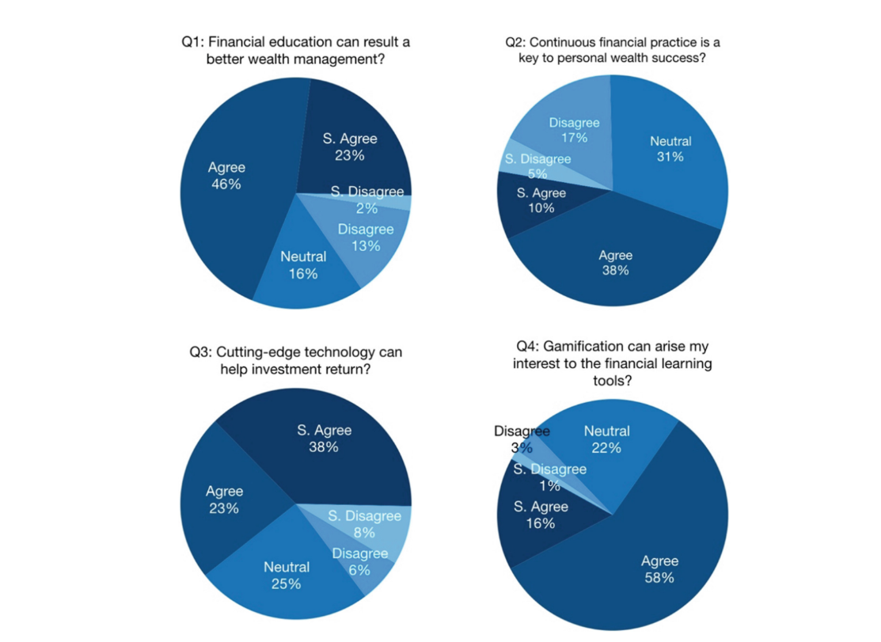
RELATED SURVEY

Slide 10
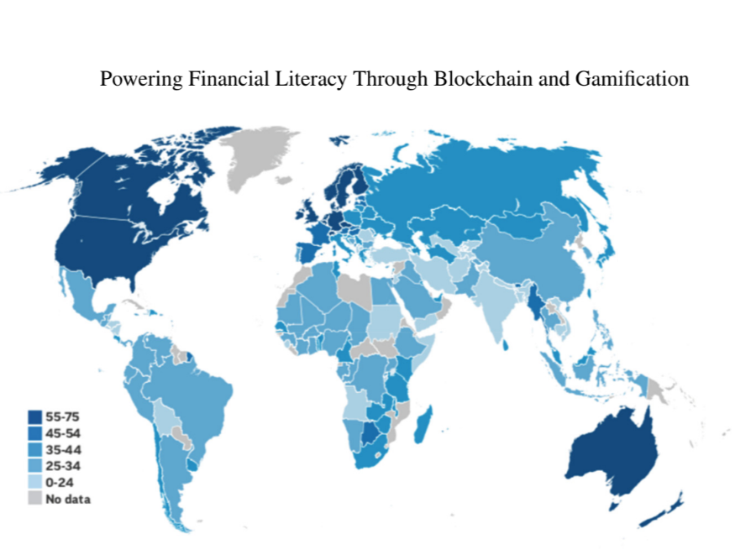
RELATED SURVEY

Slide 11
PROPOSED SYSTEM: INTERACTIVE LEARNING FRAMEWORK
Animation & Gamification-Based Learning
Animated & Interactive Modules
AI-powered chatbot for Learning Assistance
AI-powered personalized assessments
Parental Integration

Slide 12
KEY-FEATURES of PROPOSED SYSTEM
01
02
03
04
05
Animation & Gamification-
based Learning
Animated & Interactive Modules
AI-Powered Personalized Assessments
Parental Integration
AI Powered
Chatbot for Learning Assistance

Slide 13
IMPLEMENTATION METHODOLOGY
Need Analysis
Requirement Analysis
Design
Development
Testing
Deployment
Maintenance
Figure: Waterfall Model

Slide 14
SYSTEM DEVELOPMENT LIFE CYCLE
Stage Analysis
Start
Need Analysis
Technology Analysis
Media Analysis
Data Analysis
Software
Hardware
Survey
Design
Development
Website
Coding
Website
Courses
User-Interface
Course Module
Animation,Rewards, Video,Sounds
Games/Animation
Implementation
Financial Literacy for Kids
Content Quality
Presentation
Learning-goal
alignment
End
Feedback
Accessibility
Reusability
Rewards / Motivation
Figure: System Development Life Cycle

Slide 15
E-R DIAGRAM
Name
Content
Description
Courses
Access
Age
Name
ID
Uploads
Email
Children
ID
Email
Password
Manages
Monitor
takes
Password
Admin
ID
Parent
Email
Monitor
Children_ID
Password
Assessment
Answer
Assessment_types
Questions
Figure: E-R Diagram

Slide 16
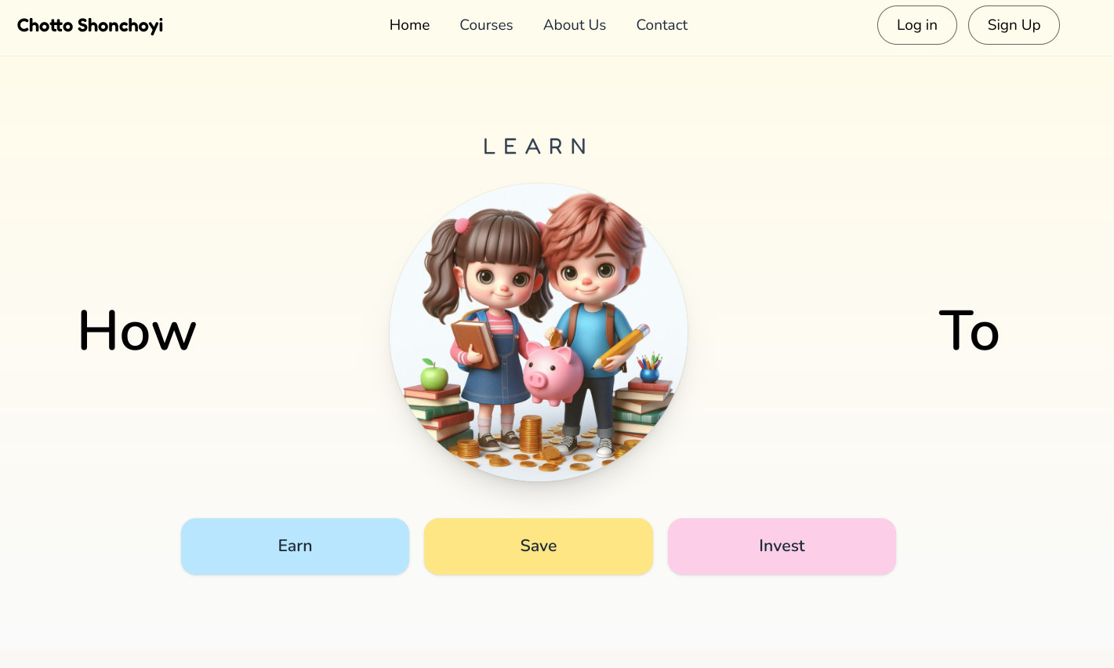
Animation based Learning

Slide 17
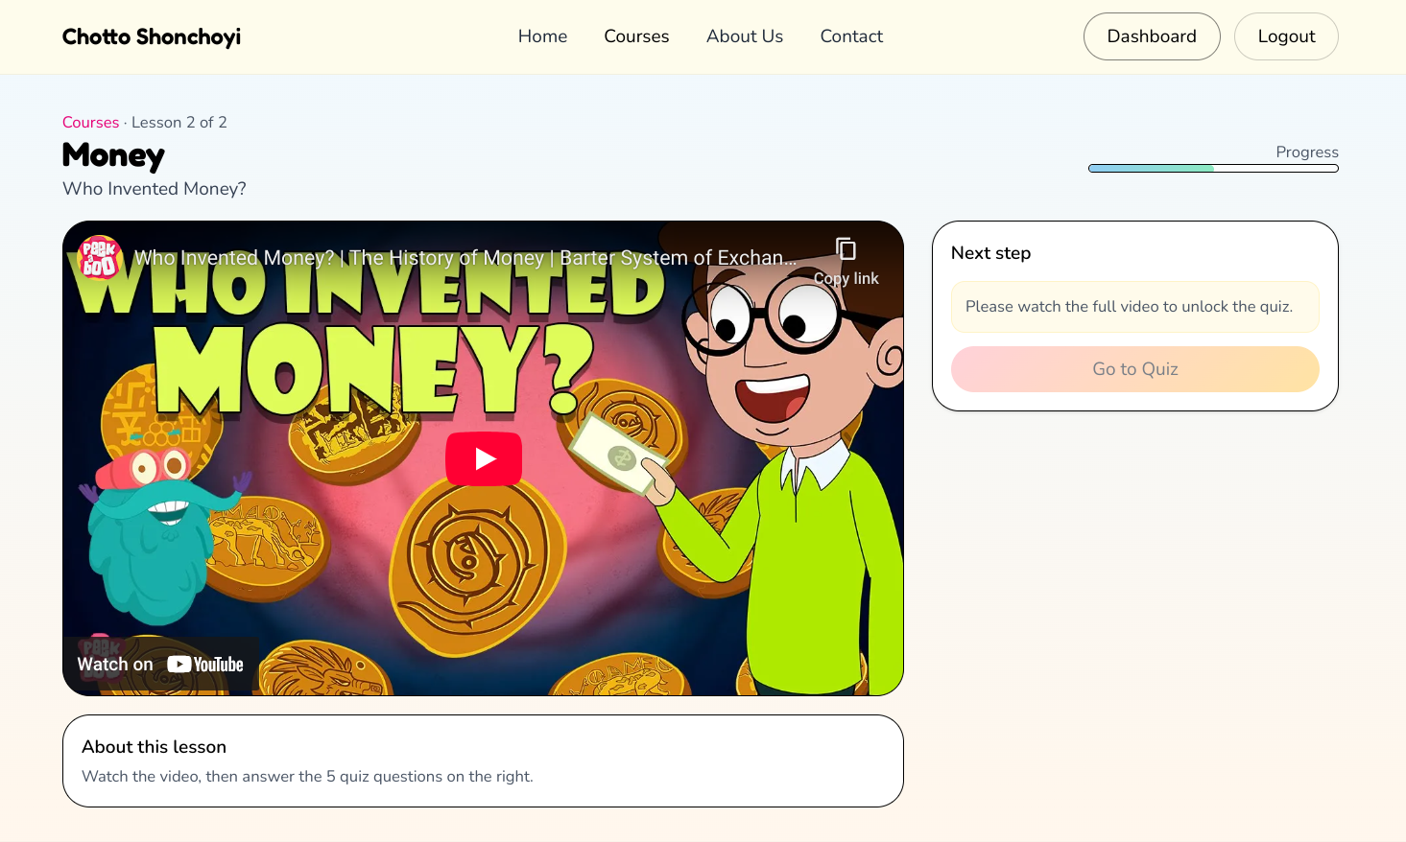
Animated & Interactive Modules

Slide 18
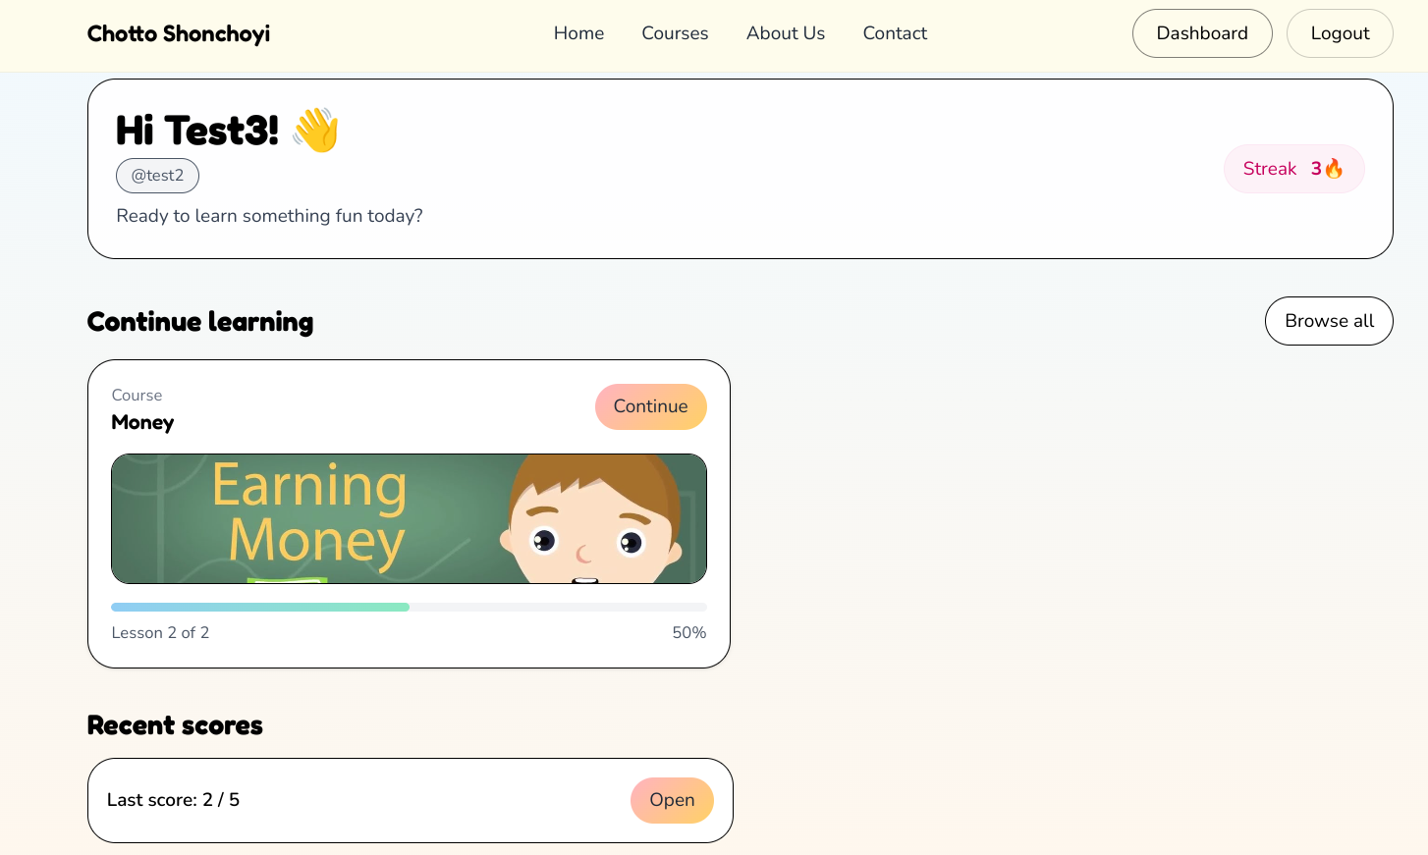
AI-Powered Personalized Assessments

Slide 19
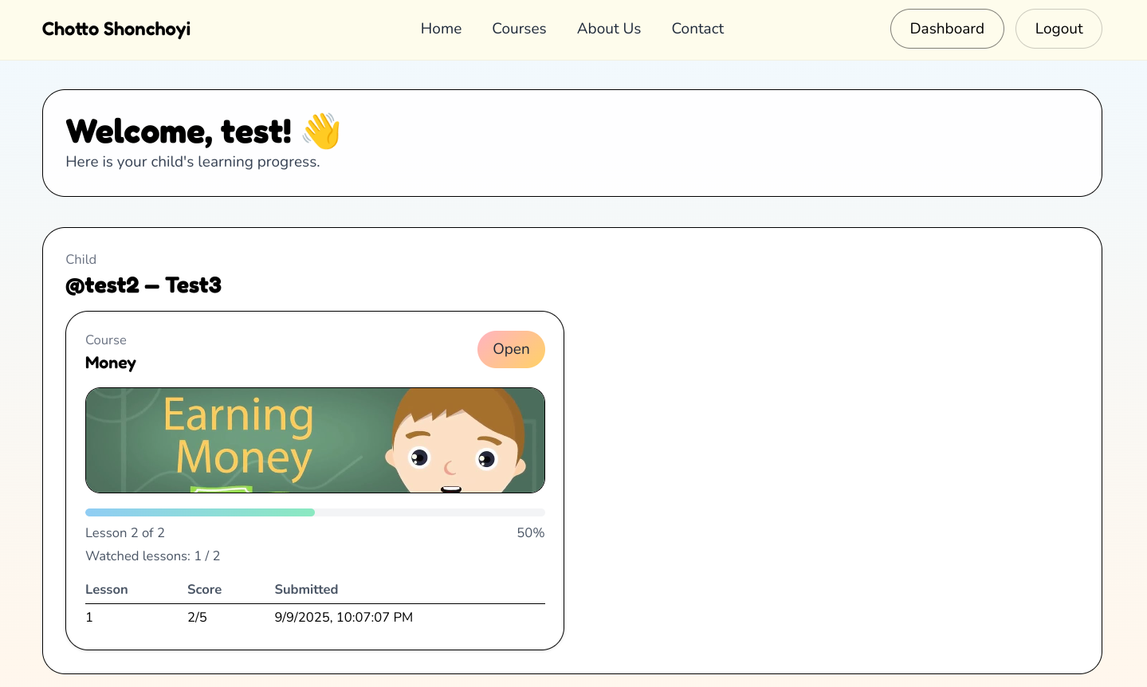
Parental Integration

Slide 20
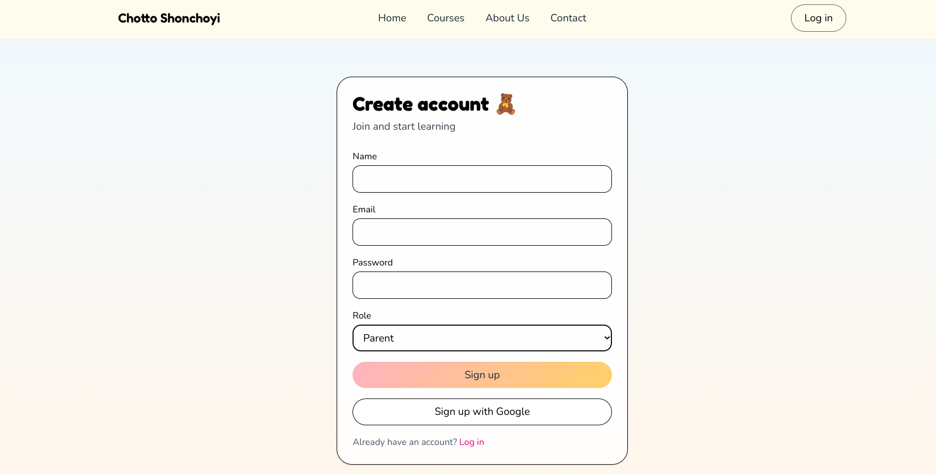
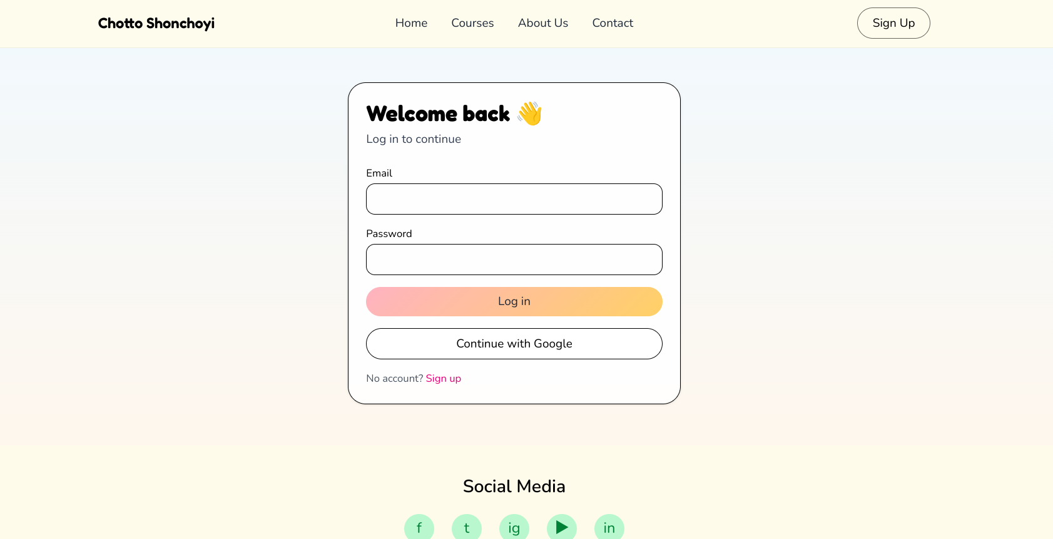
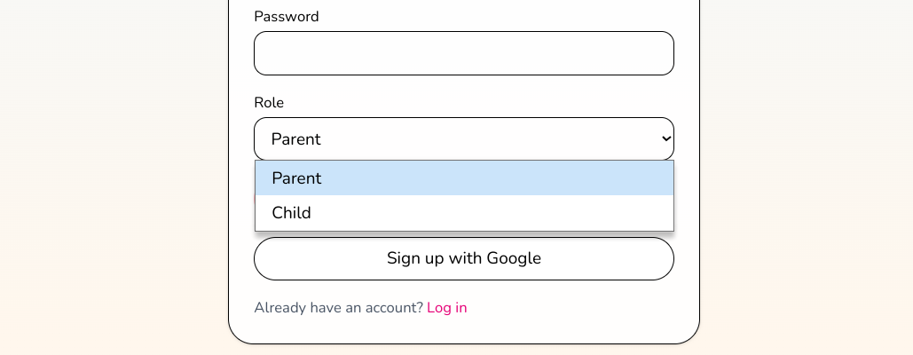
ACCOUNT CREATION
For Sign UP
Click on Sign Up
Enter Name, Mail/Number,Age,Password,Select Gender
Click Sign Up
For Log In
Click on Log In
Enter Name, Password
Click Log In.

Slide 21
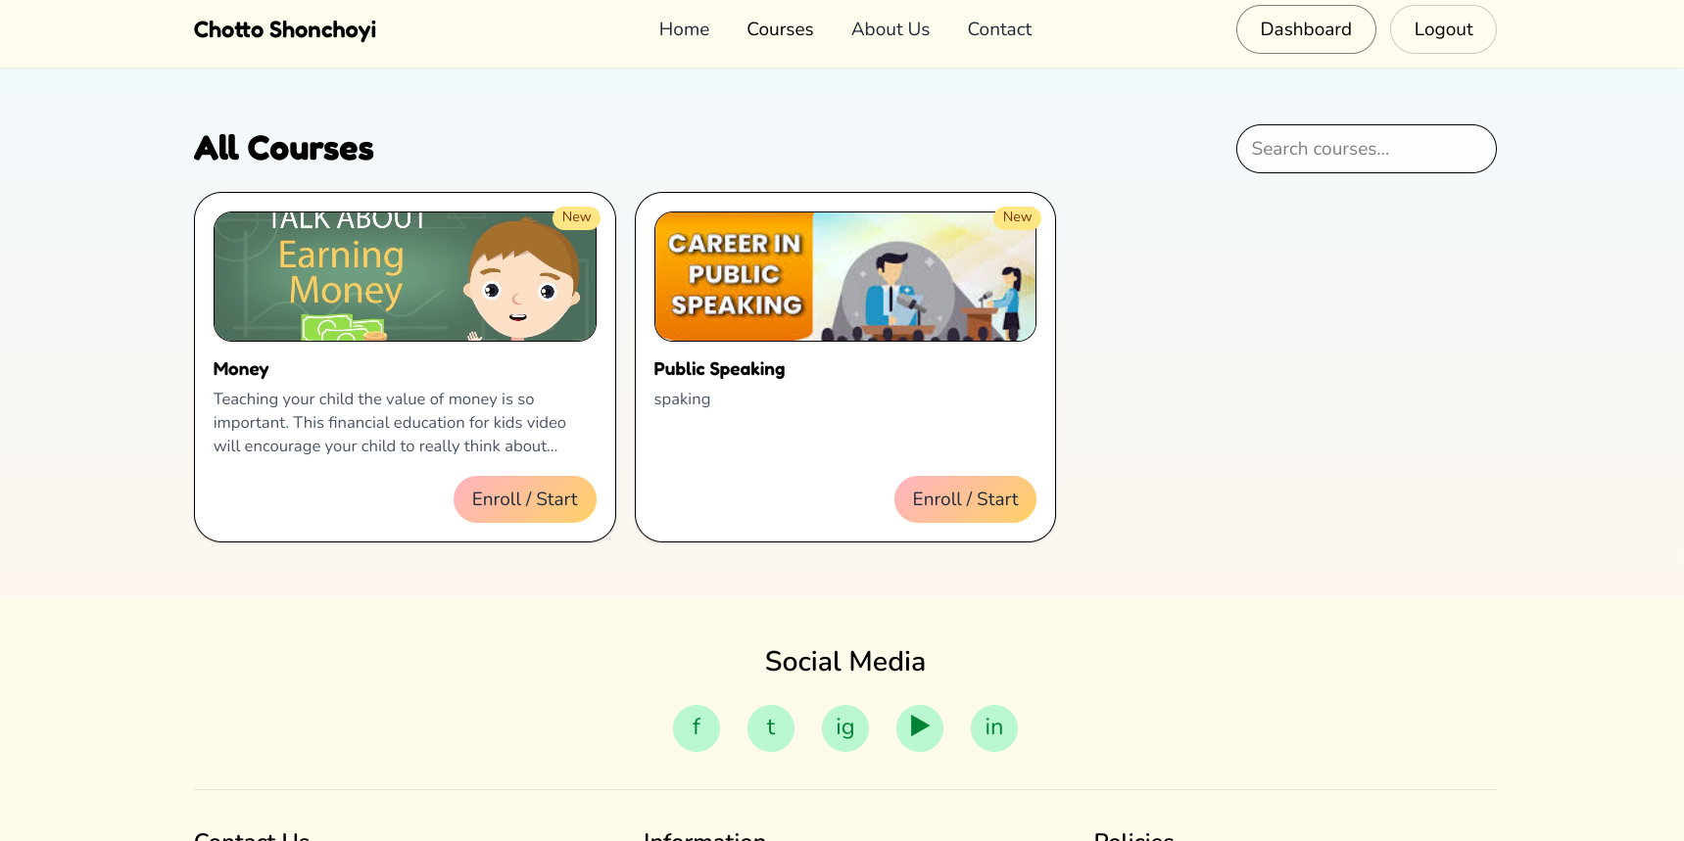
BROWSE COURSES
Click on Courses
Explore All Courses.

Slide 22
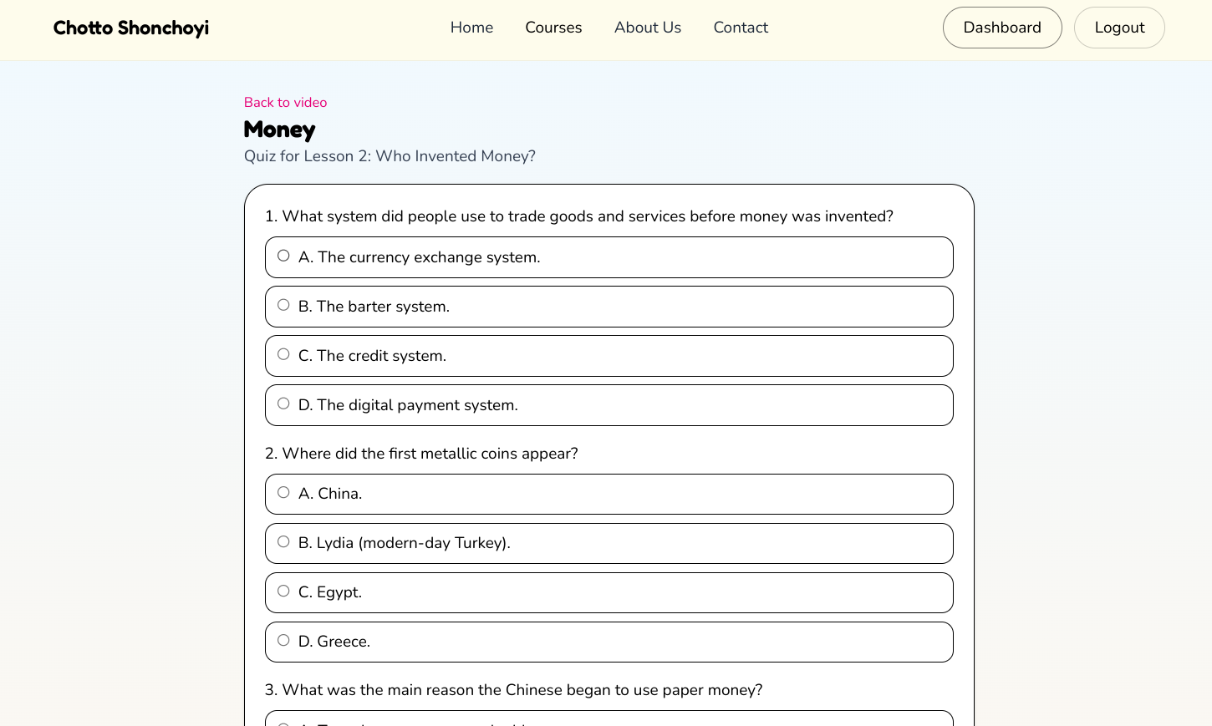
BROWSE MODULES
Click on Courses
Select a course
Browse Course Module, Quiz

Slide 23
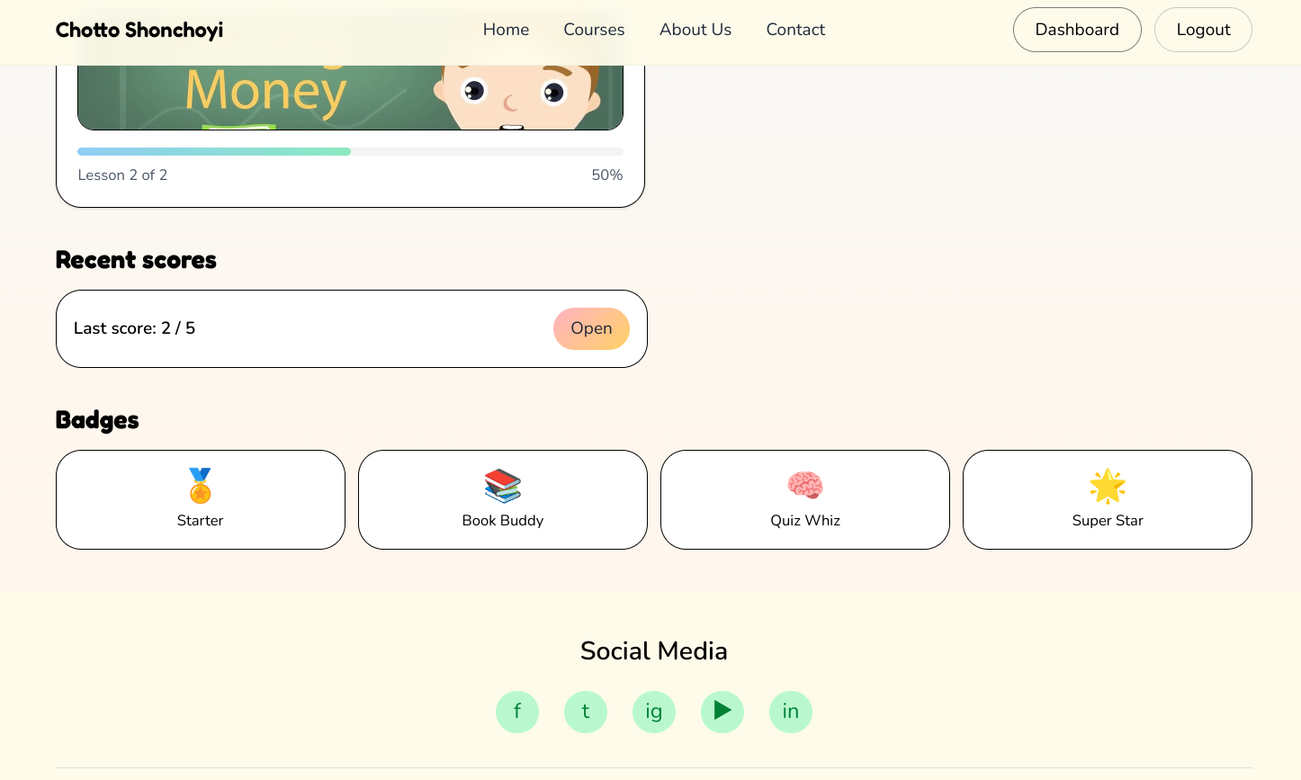
UPDATES
Click on Dashboard
Browse Completed courses, In Progress courses and Enrolled courses,Achievements.

Slide 24
STATEMENT
The proposed solution leverages AI-powered learning to address the critical issue of financial literacy. The use of AI ensures that each learning experience is tailored to the child's progress, providing them with personalized guidance and support at every step.

Slide 25

Thank You

